Slide 1
Dynamic Models- Lecture 2
Instructor: Sanghyuk Lee
Sanghyuk.Lee@xjtlu.edu.cn
Tel: 8816-1415
Department of Electrical and Electronic Engineering
XJTLU

Slide 2
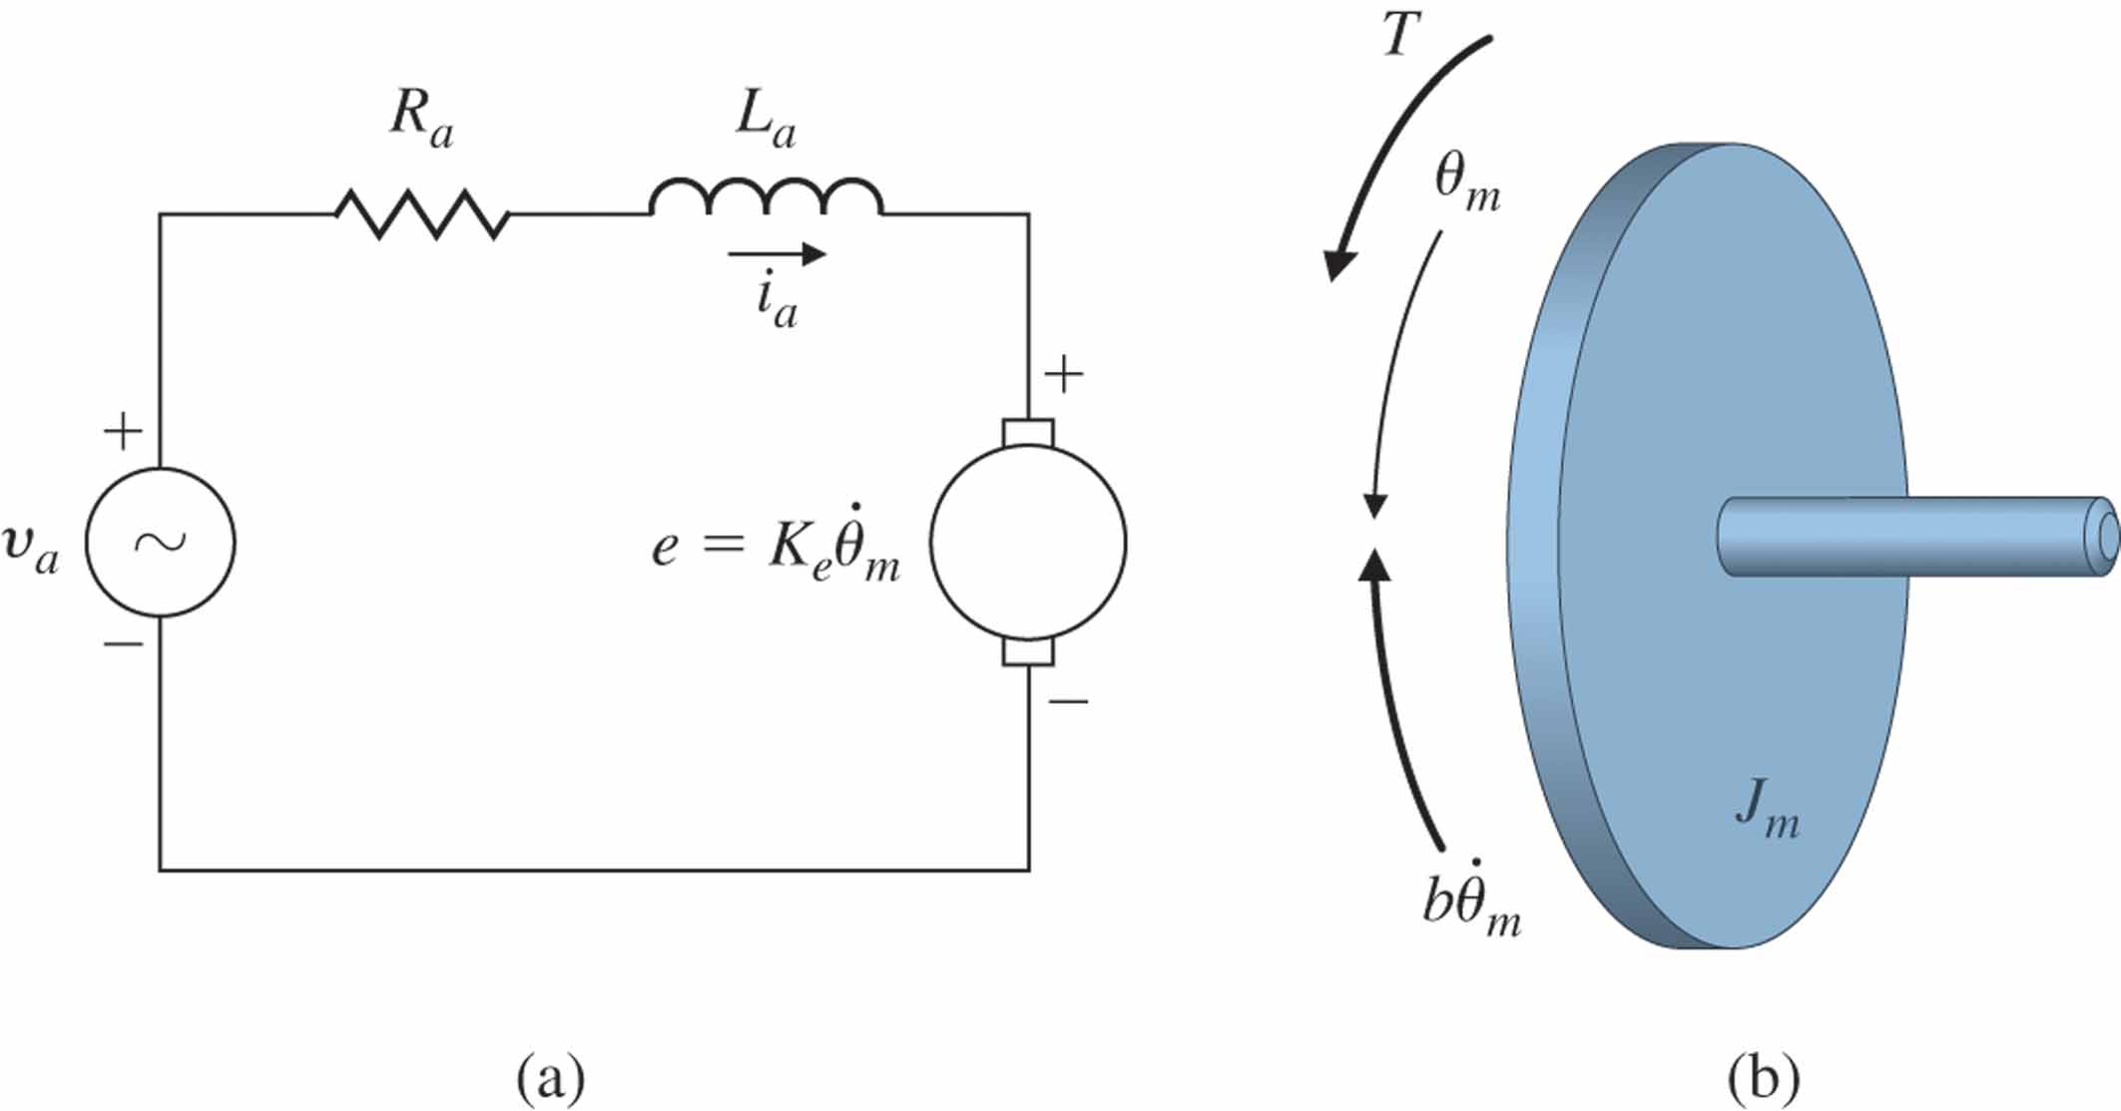
Contents
System Modelling
State Space Realization – Time domain
System Types – Linear/Nonlinear, lumped/distributed
Relation with Frequency domain – Laplace transform
System Response – Performance/Stability

Slide 3
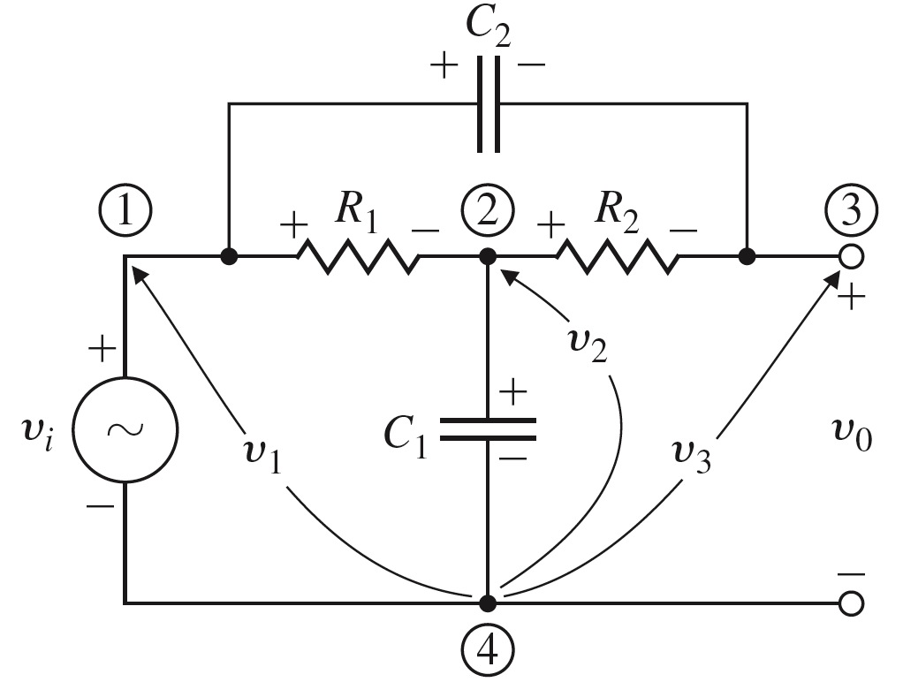
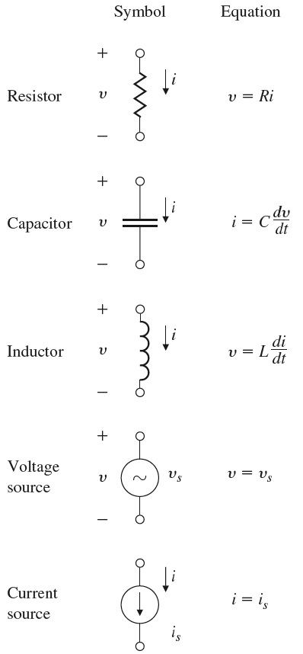
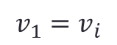
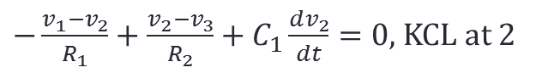
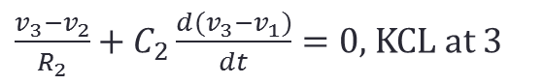
Elements of electric circuits
Digital Control and Automatic Control - Modelling EE327

Slide 4
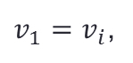
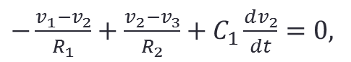
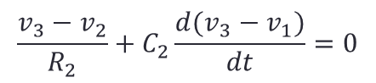
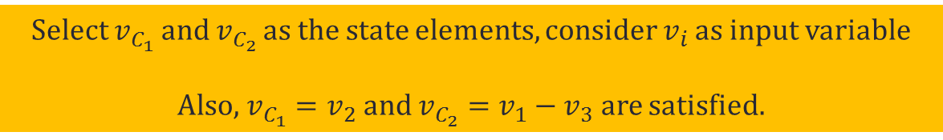
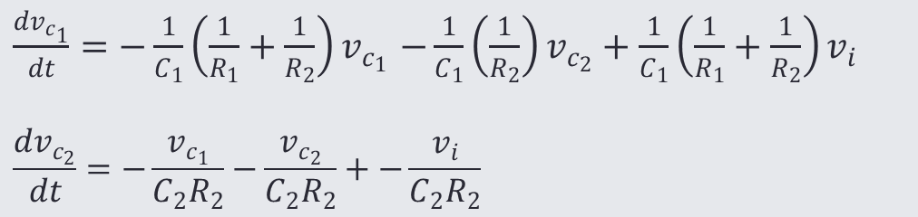
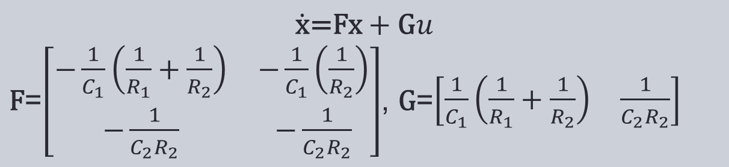
Elements of electric circuits
Digital Control and Automatic Control EEE327

Slide 5
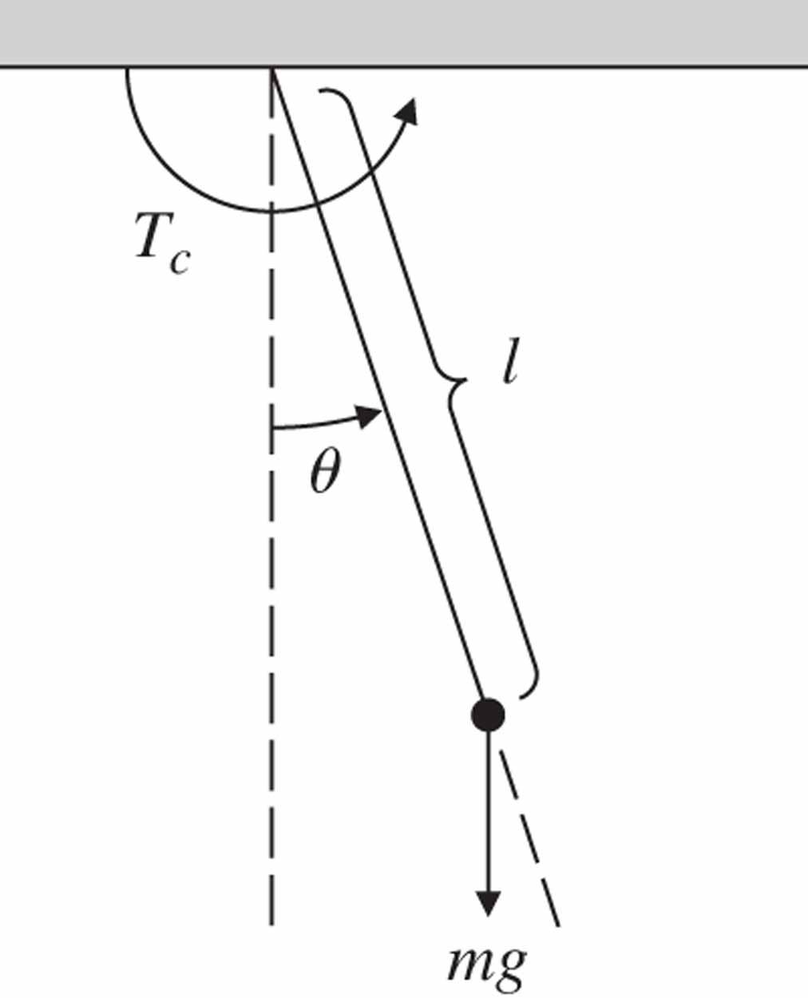
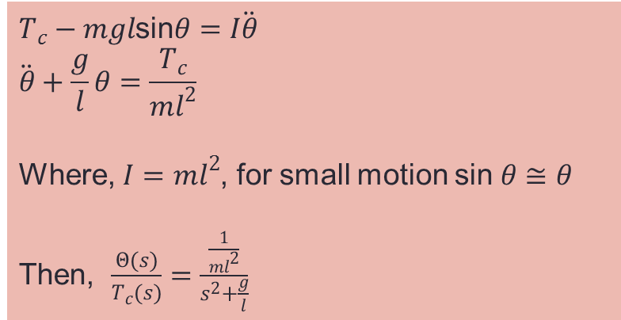
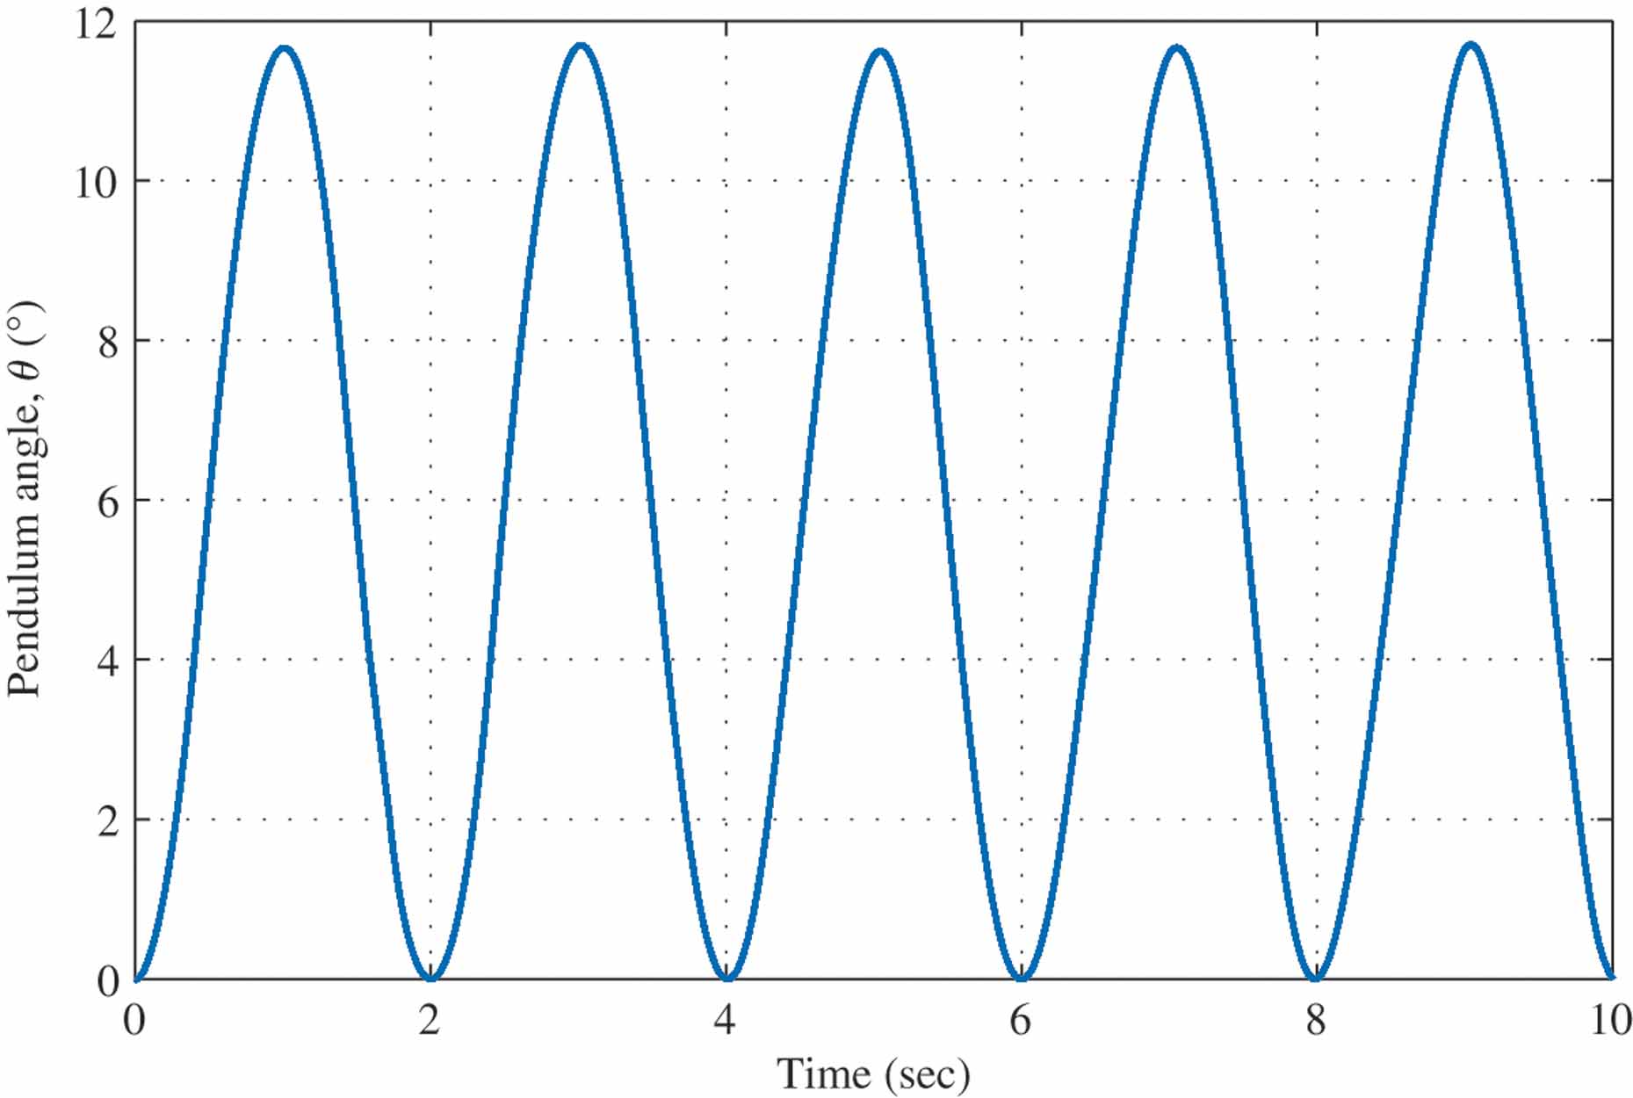
Pendulum
Digital Control and Automatic Control EEE327
Time history
Response of the pendulum to a step input of 1 N-m in the applied torque

Slide 6
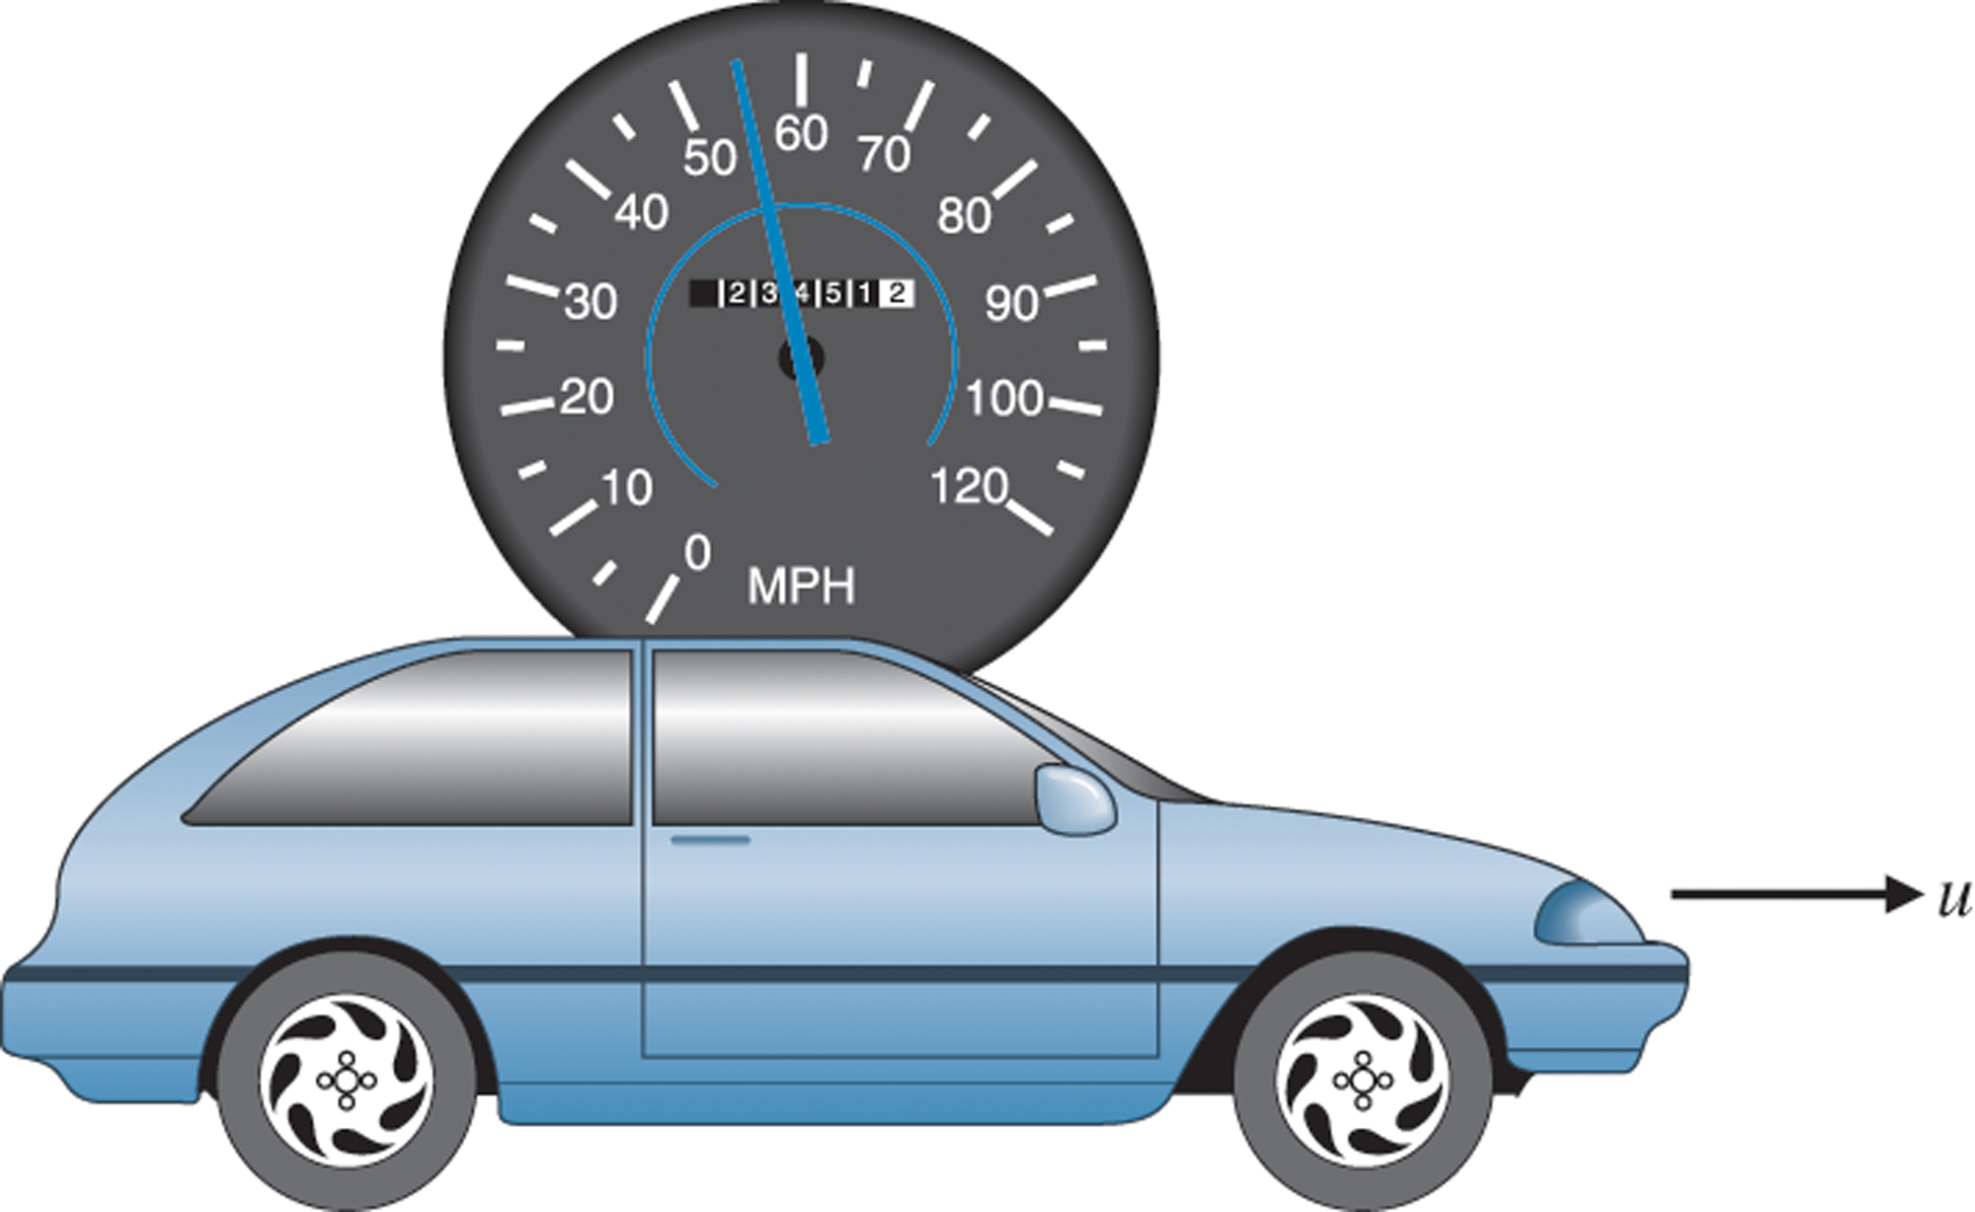
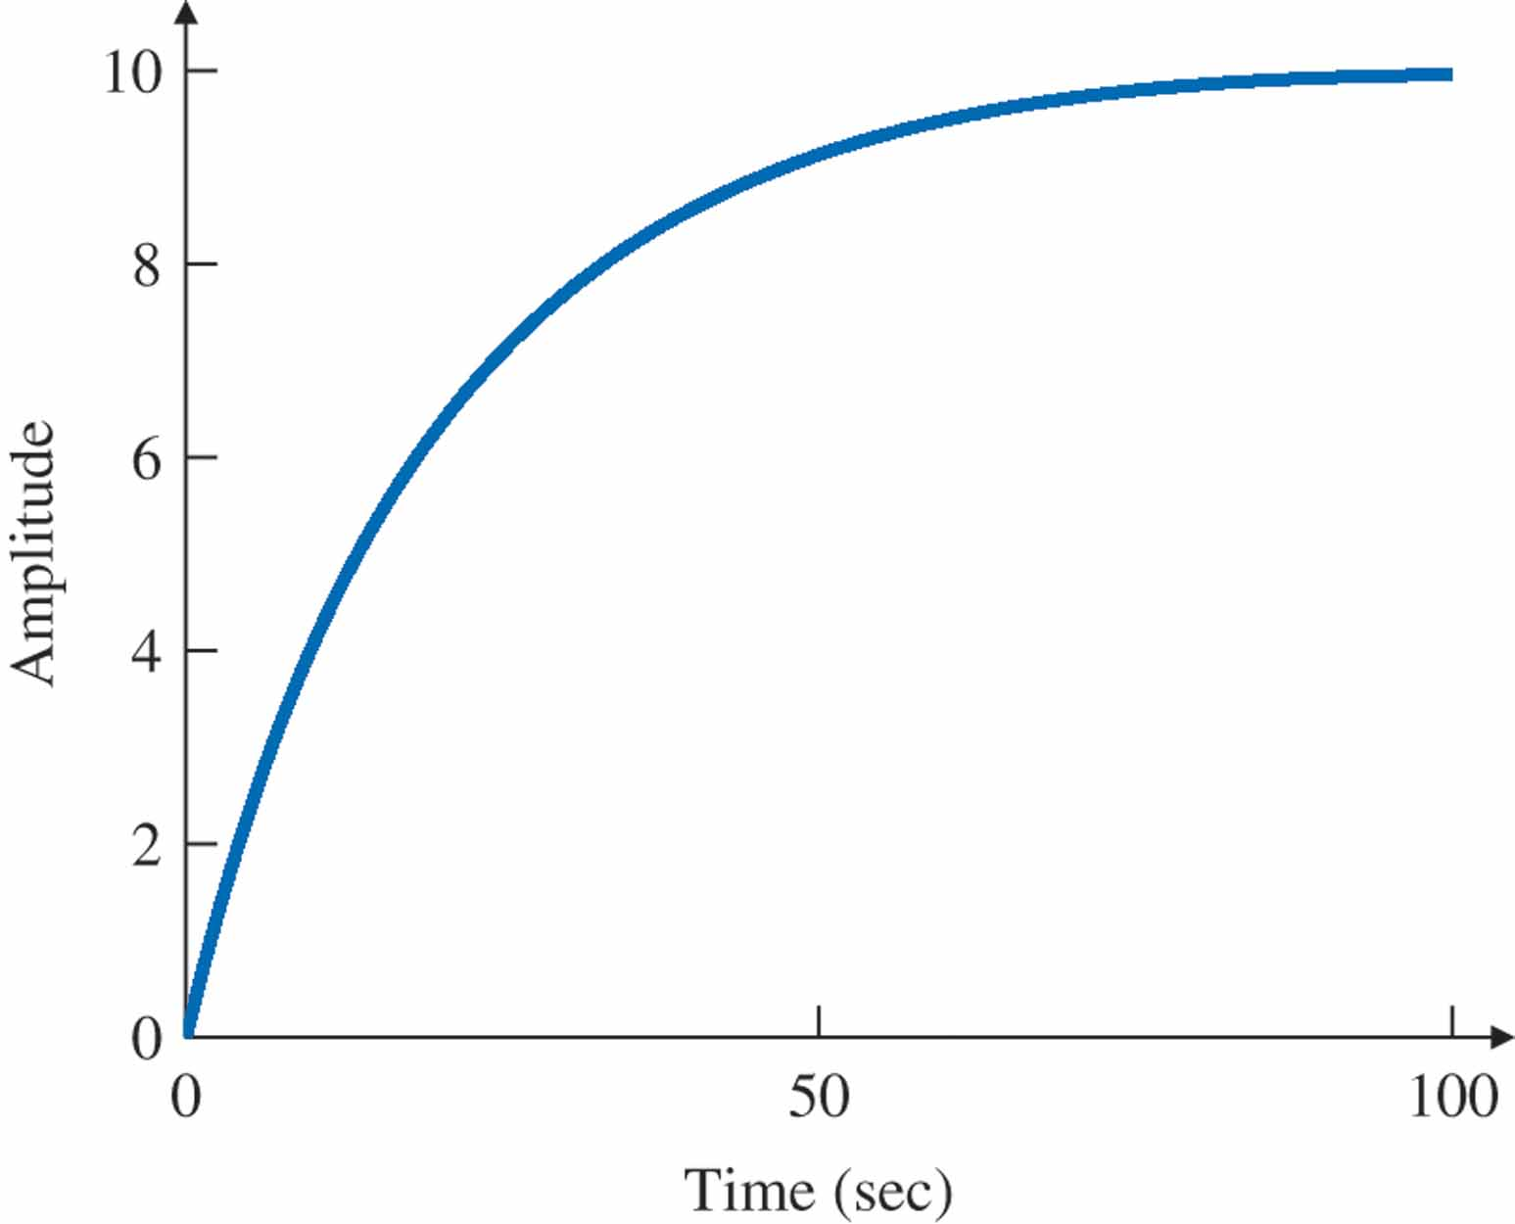
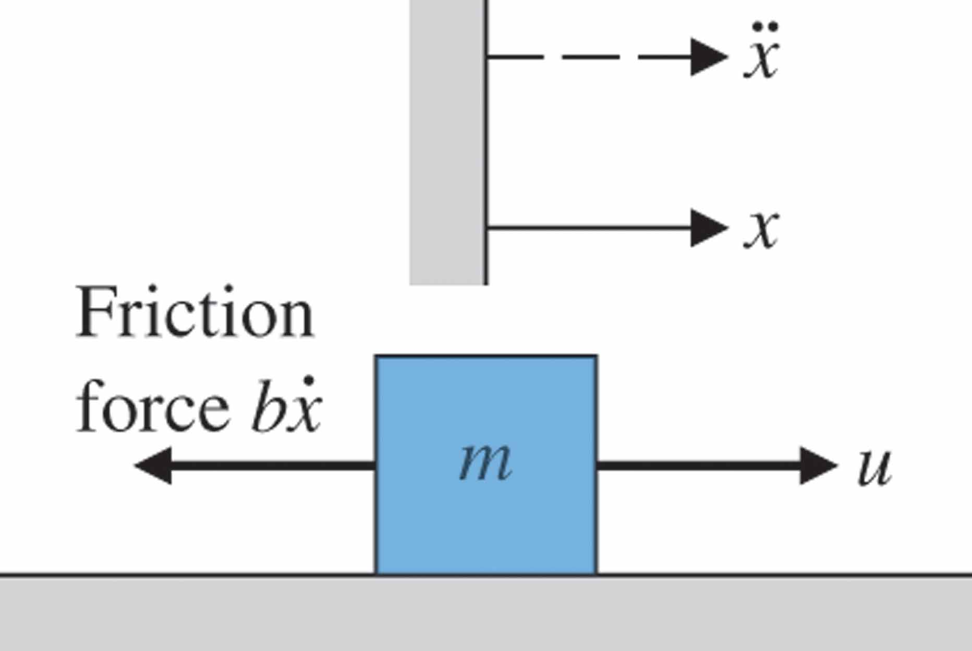
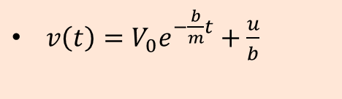
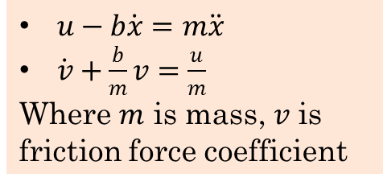
Cruise control model
Digital Control and Automatic Control –Examples EEE327
Modelling
$u−b\dot{x}=m\ddot{x}$
$\dot{v}+\frac{b}{m}v=\frac{u}{m}$
Where $m$ is mass, $v$ is friction force coefficient
Solution
$v\left(t\right)=V_{0}e^{−\frac{b}{m}t}+\frac{u}{b}$
Response of the car velocity to a step in u
Free-body diagram for cruise control

Slide 7
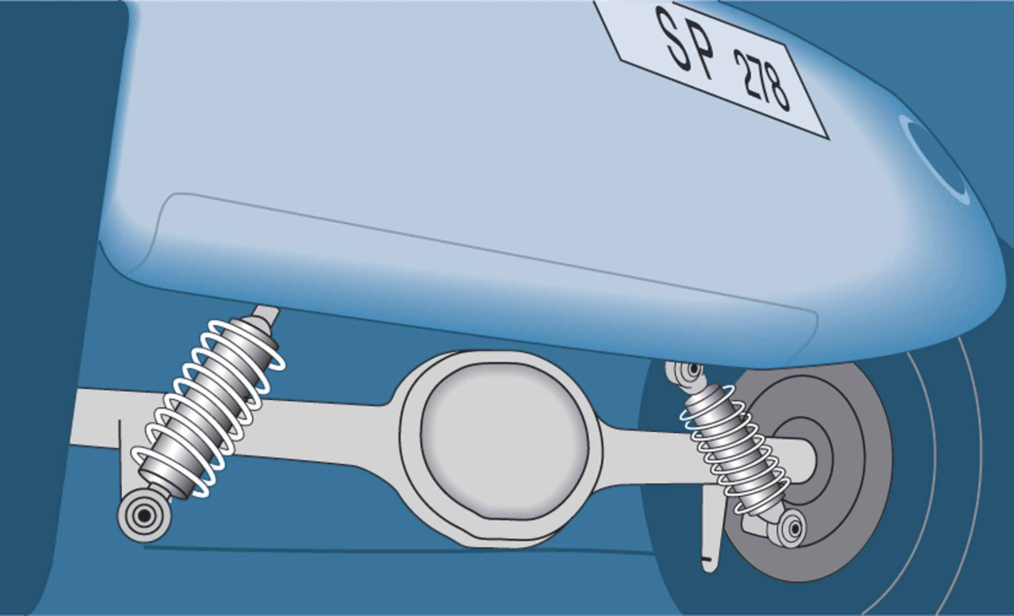
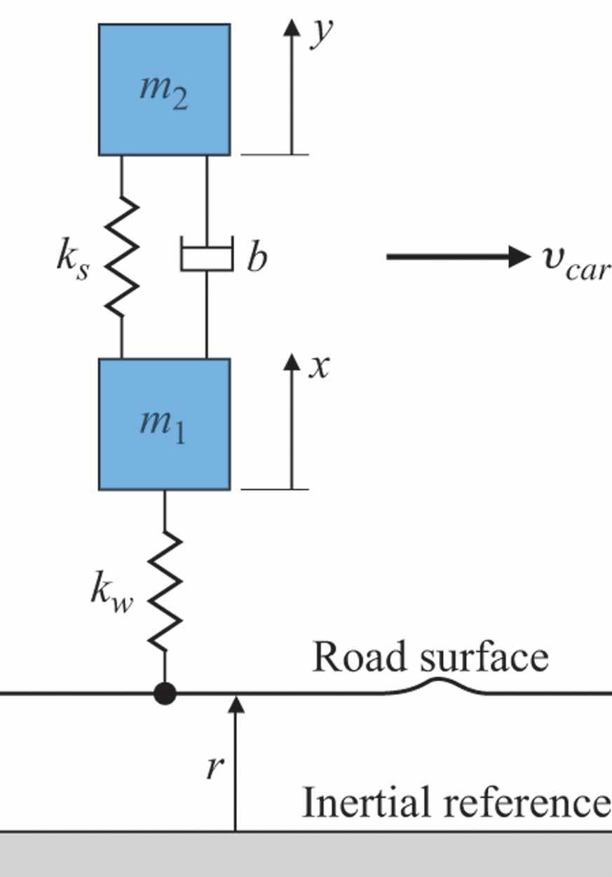
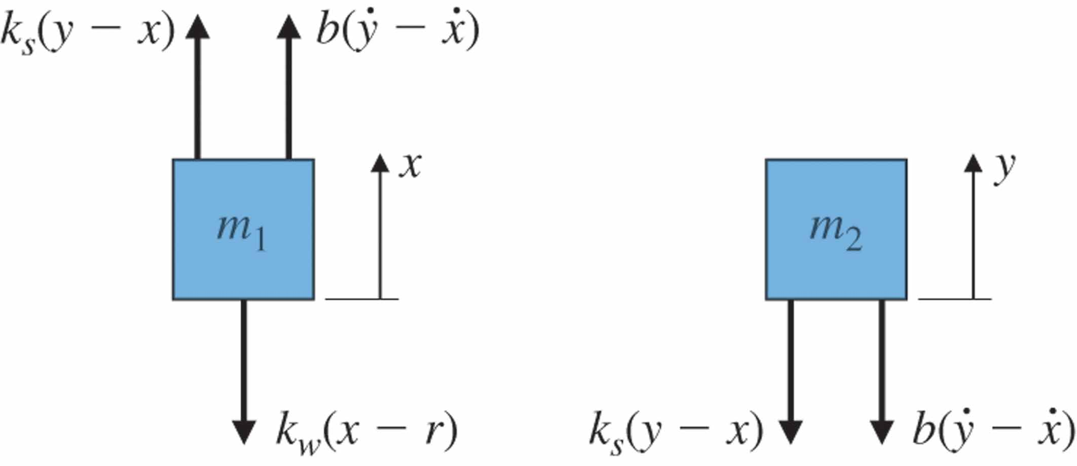
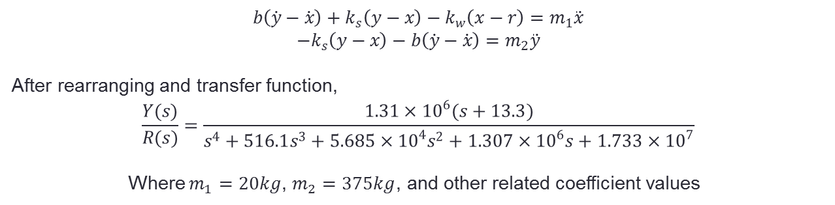
Automobile suspension
Digital Control and Automatic Control EEE327
Free-body diagrams for suspension system
The quarter-car model

Slide 8
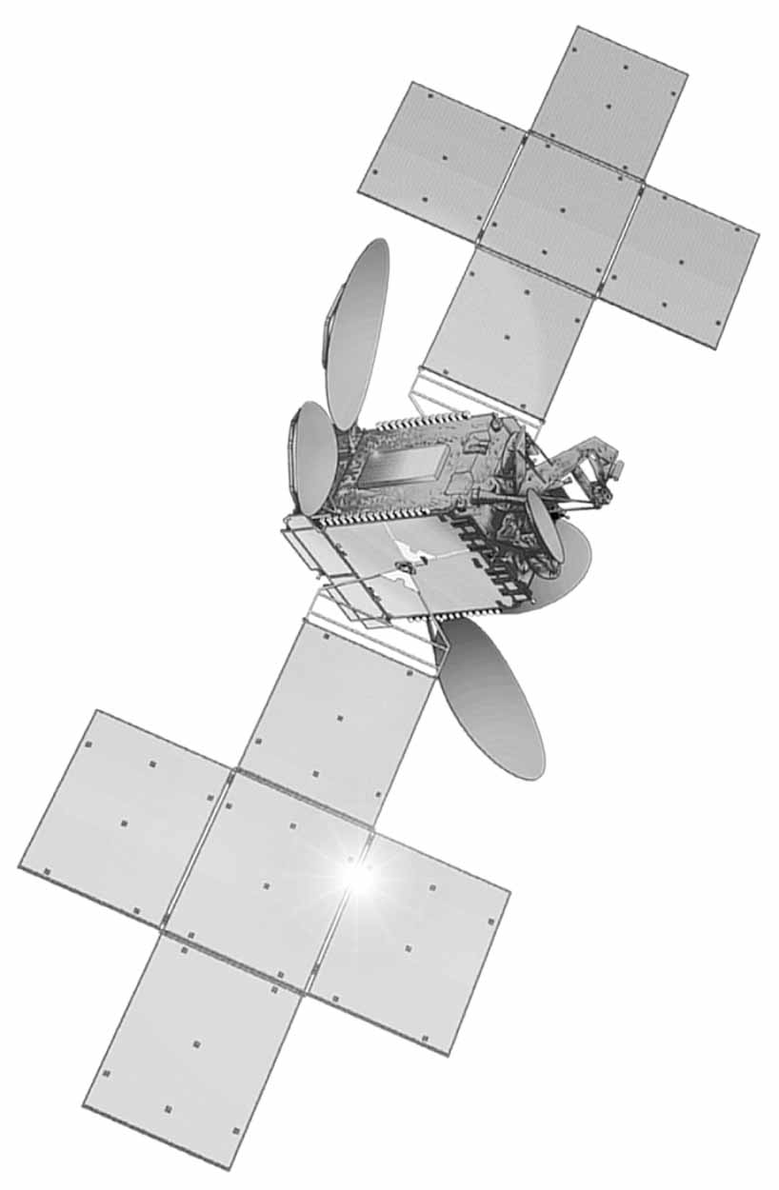
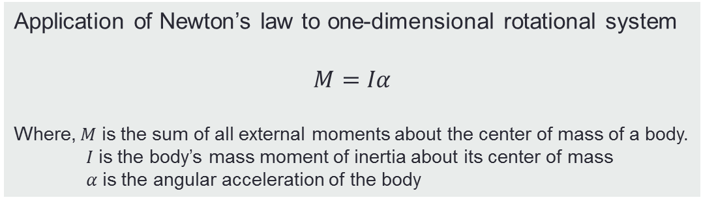
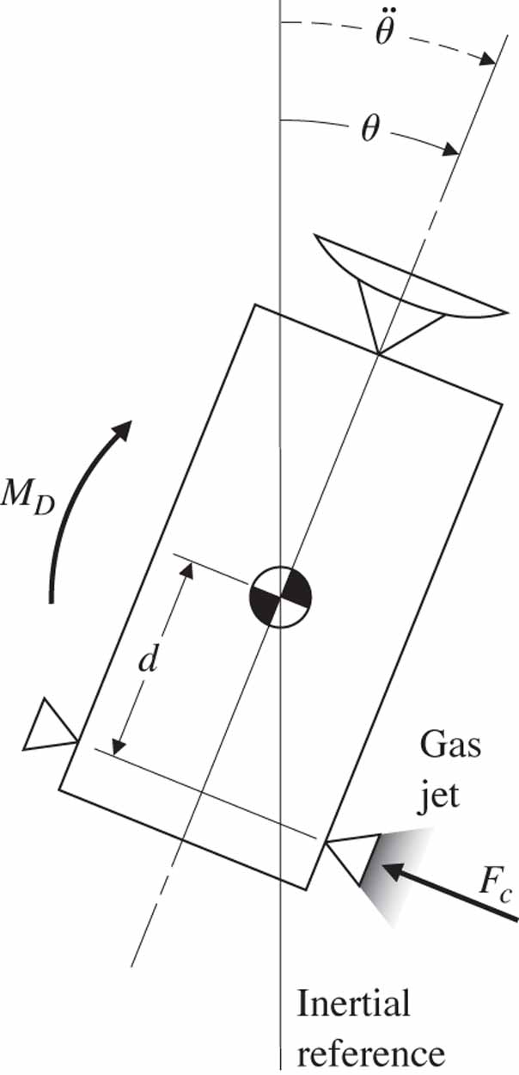
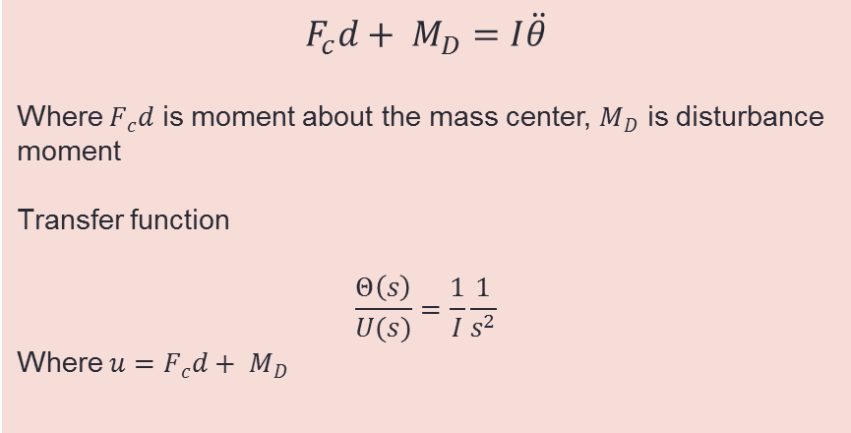
Communications satellite Source: Courtesy Space Systems/Loral
Digital Control and Automatic Control EEE327
Satellite control schematic

Slide 9
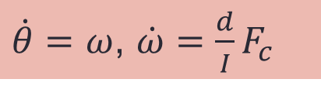
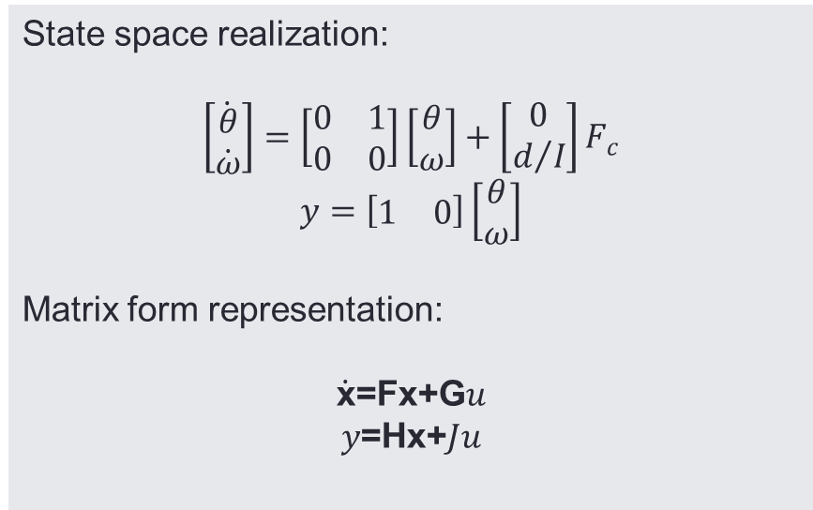
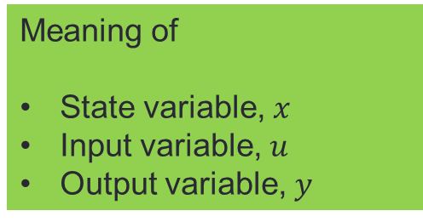
Differential Equations in State –Variable Form
Digital Control and Automatic Control EEE327
Satellite attitude Model
SISO system
MIMO system
MISO system
Which domain ?

Slide 10
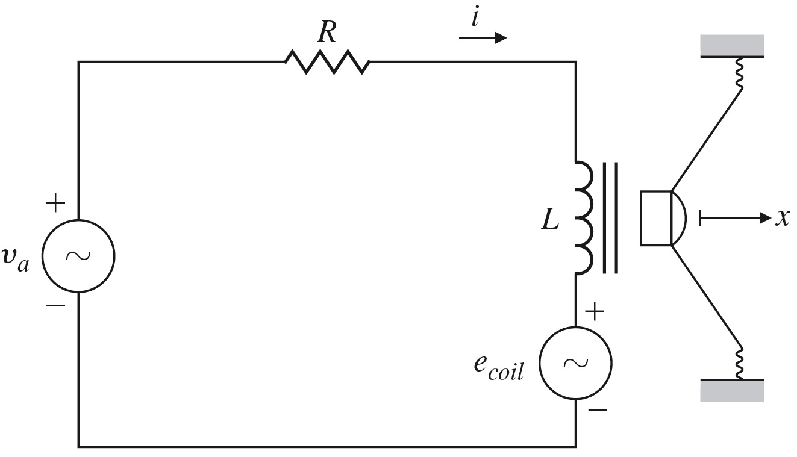
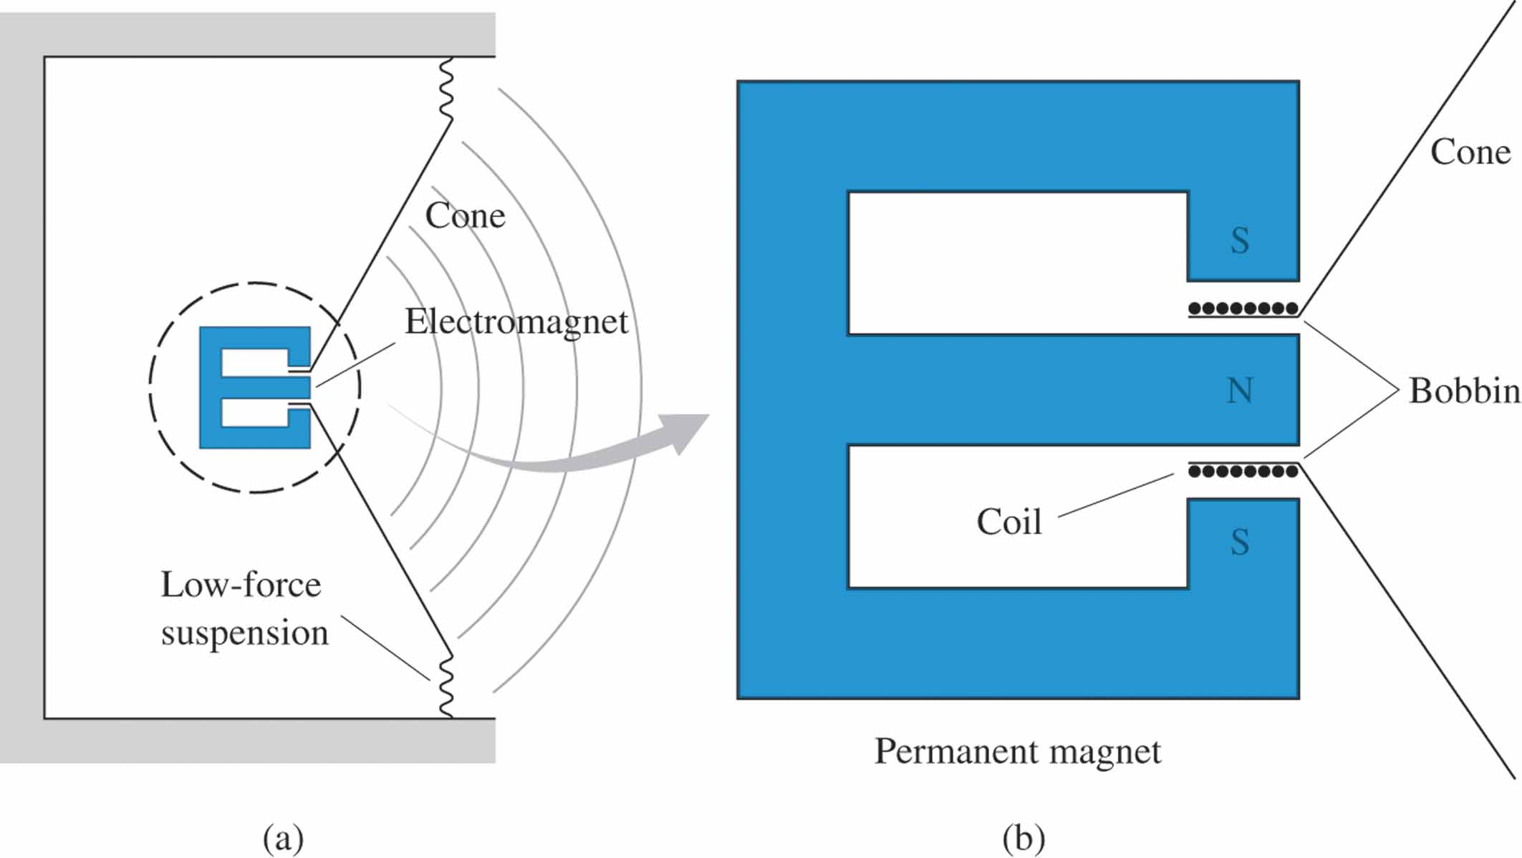
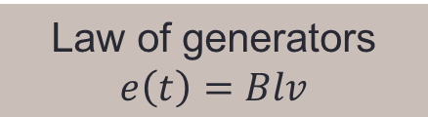

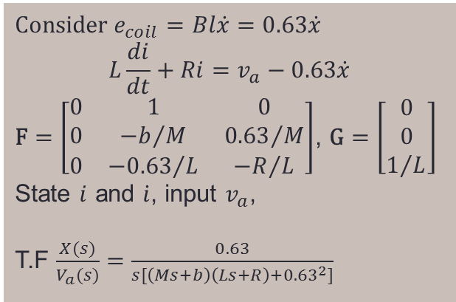
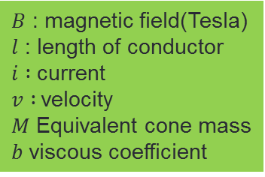
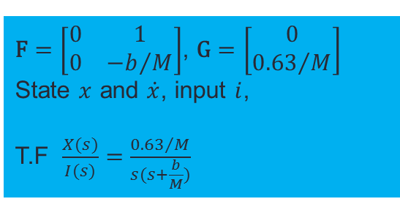
Loudspeaker and Circuit
Digital Control and Automatic Control EEE327

Slide 11
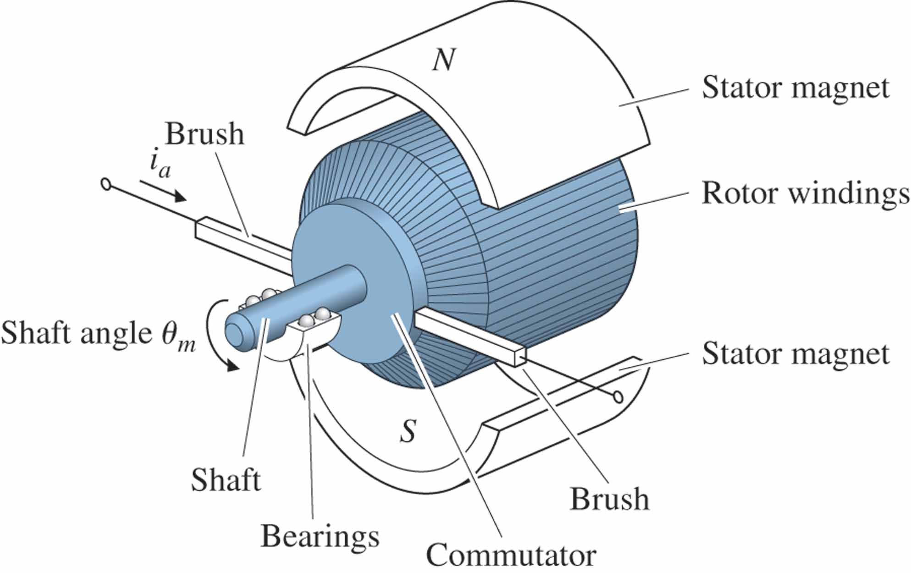
Sketch of a DC motor
Digital Control and Automatic Control EEE327

Slide 12
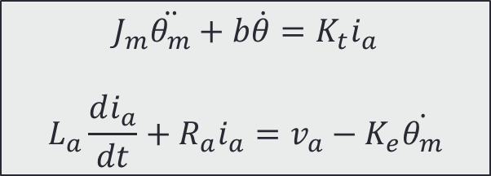
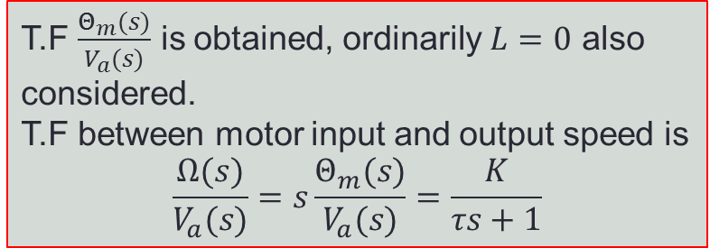
(a)electric circuit of the armature (b) free-body diagram of the rotor
Digital Control and Automatic Control EEE327

Slide 13
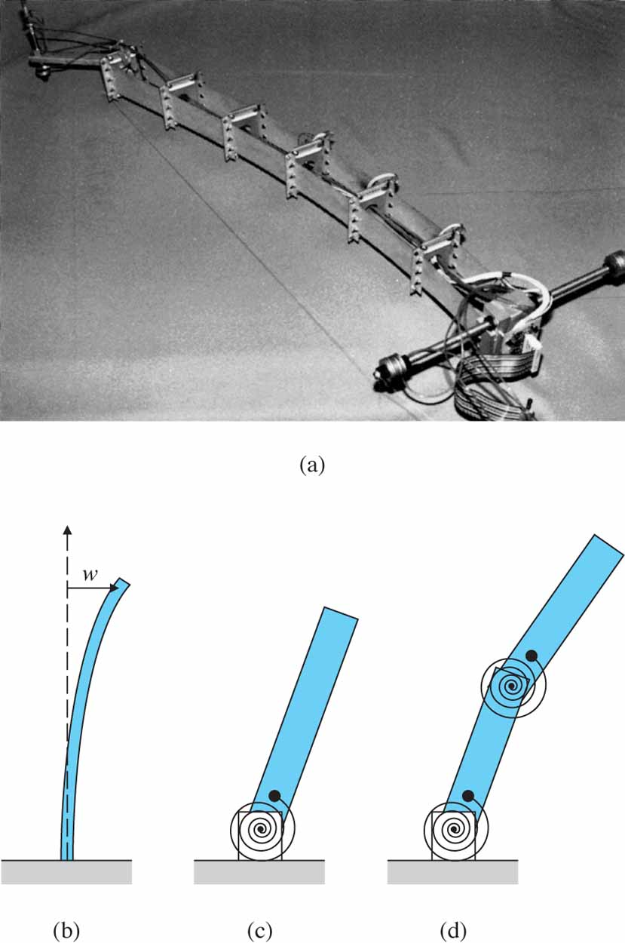
(a) Flexible robot arm used for research at Stanford University; (b) model for a continuous flexible beam; (c) simplified model for the first bending mode; (d) model for the first and second bending modes Source: Photo courtesy of E. Schmitz
Digital Control and Automatic Control – extension to distributed parameter
EEE327
Distributed Parameter Systems
Partial difference equation
Versus to lumped parameter systems
Make ordinary differential Eq. via Finite difference method
Example : Heat exchanger, flexible bodies, etc.

Slide 14
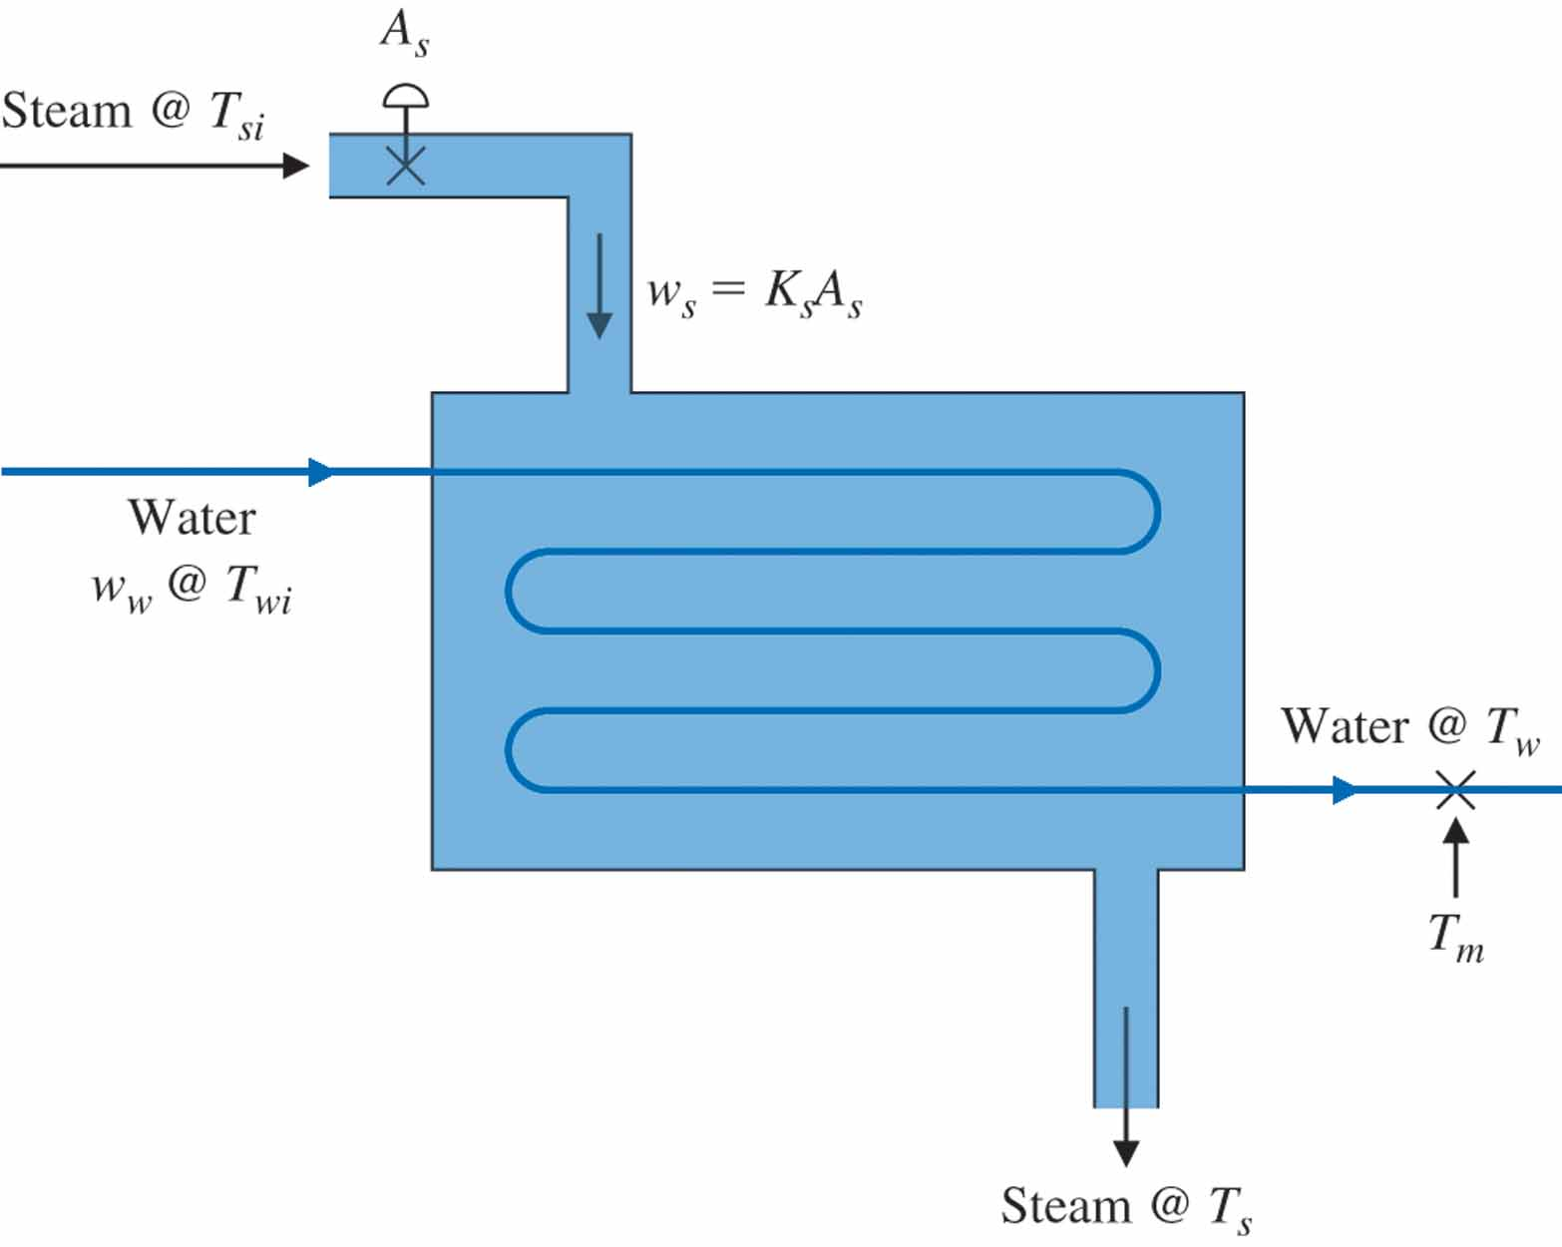
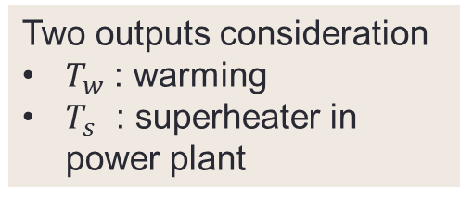
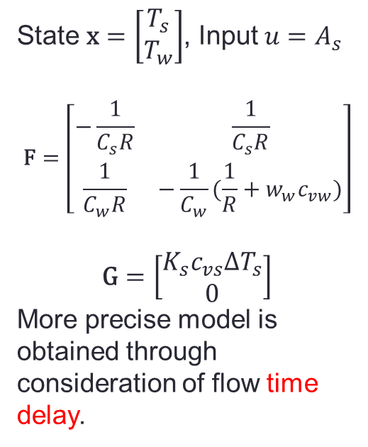
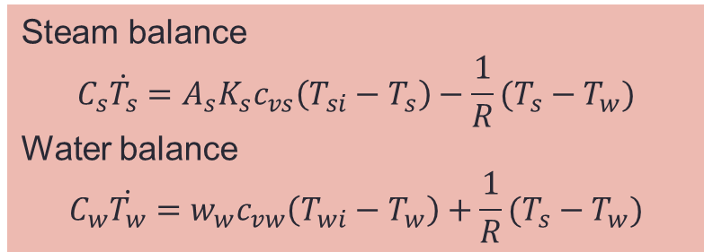
Heat exchanger
Digital Control and Automatic Control EEE327

Slide 15
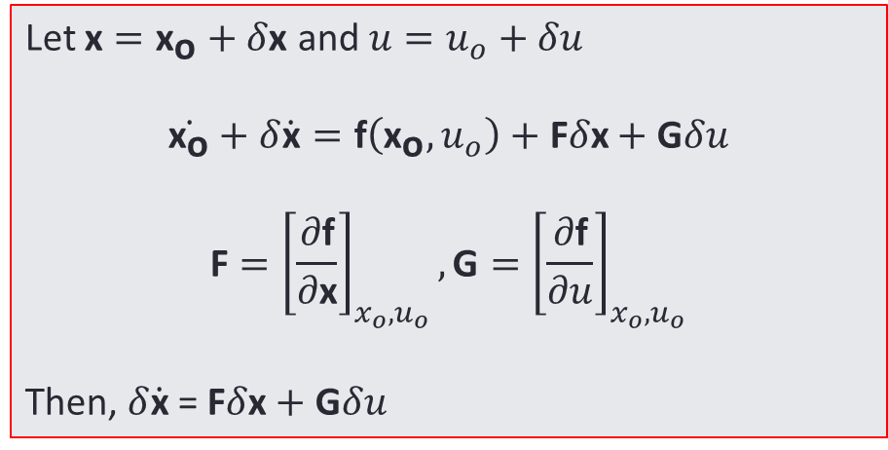
Digital Control and Automatic Control EEE327
Linearization and Scaling
What is Linear/Nonlinear differential equation ?

Slide 16
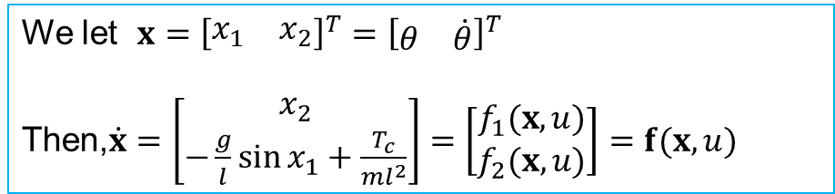
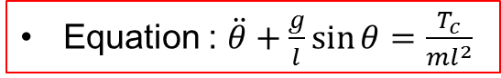
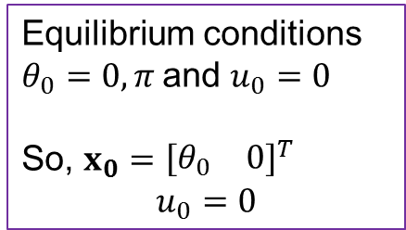
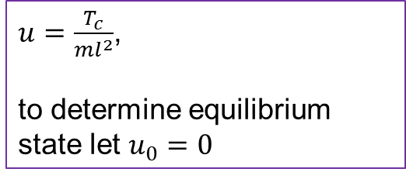

Linearization of Nonlinear Pendulum
Digital Control and Automatic Control EEE327
Equation : $\ddot{θ}+\frac{g}{l}\sin{θ}=\frac{T_{c}}{ml^{2}}$
We let $x={\left[\begin{matrix}x_{1} & x_{2}\end{matrix}\right]}^{T}={\left[\begin{matrix}θ & \dot{θ}\end{matrix}\right]}^{T}$
Then,$\dot{x}=\left[\begin{matrix}x_{2} \\ −\frac{g}{l}\sin{x_{1}}+\frac{T_{c}}{ml^{2}}\end{matrix}\right]=\left[\begin{matrix}f_{1}(x,u) \\ f_{2}(x,u)\end{matrix}\right]=f(x,u)$
$u=\frac{T_{c}}{ml^{2}}$,
to determine equilibrium state let $u_{0}=0$
$\dot{x_{1}}=\dot{θ}=0$,
$$\dot{x_{2}}=\ddot{θ}=−\frac{g}{l}\sin{θ}=0$$
$F=\left[\begin{matrix}\frac{∂f_{1}}{∂x_{1}} & \frac{∂f_{1}}{∂x_{2}} \\ \frac{∂f_{2}}{∂x_{1}} & \frac{∂f_{2}}{∂x_{2}}\end{matrix}\right]=\left[\begin{matrix}0 & 1 \\ −\frac{g}{l}\cos{θ_{0}} & 0\end{matrix}\right]$, $G=\left[\begin{matrix}\frac{∂f_{1}}{∂u} \\ \frac{∂f_{2}}{∂u}\end{matrix}\right]=\left[\begin{matrix}0 \\ 1\end{matrix}\right]$
$$\dot{x}=F\left[\begin{matrix}δθ \\ δ\dot{θ}\end{matrix}\right]+Gu$$
Equilibrium conditions $θ_{0}=0, π$and $u_{0}=0$
So, $x_{0}={\left[\begin{matrix}θ_{0} & 0\end{matrix}\right]}^{T}$
$$u_{0}=0$$

Slide 17



Laplace Transform
Digital Control and Automatic Control EEE327
One method to solve differential equation
Transformation of function from time domain to frequency domain
Only for linear differential equation
Definition(One sided/Unilateral )
$$F(s)≜\int_{0−}^{∞}{f\left(t\right)e^{−st}dt}$$
$$f\left(t\right)=\frac{1}{2πj}\int_{σ_{c}−j∞}^{σ_{c}+j∞σ_{c}}{F\left(s\right)e^{st}ds}$$
$$s=σ+jω$$
$σ_{c}$ is a selected value to the right of all the singularities of $F(s)$ in the $s$ plane.
Example.
For $f\left(t\right)=a1\left(t\right), bt1(t)δ\left(t\right), \sin{ωt}$,
with the definition of
$$F(s)≜\int_{0−}^{∞}{f\left(t\right)e^{−st}dt}$$
Results are obtained easily
$$F\left(s\right)=\frac{a}{s}, \frac{b}{s^{2}}, 1, \frac{ω}{s^{2}+ω^{2}}$$

Slide 18


Properties of Laplace transform
Superposition
$ℒ\left\{αf_{1}\left(t\right)+βf_{2}\left(t\right)\right\}=αsF_{1}\left(s\right)+βF_{2}(s)$
Time delay
$$F_{1}\left(s\right)=\int_{0}^{∞}{f\left(t−λ\right)e^{−st}dt}=e^{−sλ}F(s)$$
Time scaling
$$F_{1}\left(s\right)=\int_{0}^{∞}{f\left(t\right)e^{−st}dt}=\frac{1}{|a|}F(\frac{s}{a})$$
Shift in frequency
$$F_{1}\left(s\right)=\int_{0}^{∞}{e^{−at}f\left(t\right)e^{−st}dt}=F(s+a)$$
Differentiation
$$ℒ\left\{\frac{df}{dt}\right\}=\int_{0−}^{∞}{({\frac{df}{dt})e}^{−st}dt}=−f\left(0^{−}\right)+sF(s)$$
Integration
$$F_{1}\left(s\right)=ℒ\{\int_{0}^{t}{f\left(ξ\right)dξ}=\frac{1}{s}F(s)$$
Convolution
$$ℒ\left\{f_{1}\left(t\right)∗f_{2}\left(t\right)\right\}=\int_{0}^{∞}{f_{1}\left(t\right)∗f_{2}\left(t\right)e^{−st}dt}=F_{1}(s)F_{2}(s)$$
Time product
$$ℒ\left\{f_{1}\left(t\right)f_{2}\left(t\right)\right\}=\frac{1}{2πj}F_{1}(s)∗F_{2}(s)$$
Multiplication by time
$$ℒ\left\{tf\left(t\right)\right\}=−\frac{d}{ds}F(s)$$
$$Homework\#1 :$$
Prove all properties
Due 6th. OCT.

Slide 19


Inverse Laplace transform
Digital Control and Automatic Control EEE327
Using table, compare with those of Laplace transform
With partial fraction expansion
Not easy to apply formula directly
Ordinary Transfer function
$$F\left(s\right)=\frac{b_{1}s^{m}+b_{2}s^{m−1}+⋯+b_{m+1}}{s^{n}+a_{1}s^{n−1}+⋯+a_{n}}$$
$=K\frac{\prod_{i=1}^{m}{(s−z_{i})}}{\prod_{i=1}^{n}{(s−p_{i})}}$
$=\frac{C_{1}}{(s−p_{1}) }+\frac{C_{2}}{(s−p_{2}) }+⋯+\frac{C_{n}}{(s−p_{n}) }$
Solve $C_{1}$, $C_{2}$, $⋯,C_{n}$
Poles and zeros
By inverse transform
$f\left(t\right)=\sum_{i=1}^{n}{C_{i}e^{p_{i}t}}$, for $t≥0$
Distinct real roots
Complex roots
Multiple roots
$F(s)=\frac{1}{s{\left(s+1\right)}^{3}(s+2)}$ ?
$$F\left(s\right)=\frac{1}{2s }+\frac{1}{2\left(s+2\right)}−\frac{1}{\left(s+1\right)}−\frac{1}{{(s+1)}^{3}}$$
$$f(t) =\frac{1}{2 }+\frac{1}{2}e^{−2t}−e^{−t}−\frac{1}{2}t^{2}e^{−t}$$

Slide 20




Initial value/Final value theorem
Digital Control and Automatic Control EEE327
$$\lim_{t→0}{y(t)}=\lim_{s→∞}{sY(s)}$$
$$\lim_{t→∞}{y(t)}=\lim_{s→0}{sY(s)}$$
Limit value should exist
$sY(s)$ should analytic on the imaginary axis and in the right half of $s$-plane
Solving Differential Equation via Laplace transform
$$\ddot{y}\left(t\right)+5\dot{y}\left(t\right)+4y\left(t\right)=u\left(t\right), y\left(0\right)=0, \dot{y}\left(0\right)=0, u\left(t\right)=2e^{−2t}1(t)$$
Applying Laplace transform
$s^{2}Y\left(s\right)+5sY\left(s\right)+4Y\left(s\right)=\frac{2}{(s+2)}$
Solve $Y\left(s\right)$
$$Y\left(s\right)=\frac{2}{(s+2)(s+1)(s+4)}$$
Partial fraction expansion and inverse Laplace transform
$y\left(t\right)=\left(−e^{−2t}+\frac{2}{3}e^{−t}+\frac{1}{3}e^{−4t}\right)$, $t>0$

Slide 21




Dynamic Response
Digital Control and Automatic Control EEE327
Impulse response
$$h\left(t\right)=\int_{−∞}^{∞}{h\left(τ\right)p\left(t−τ\right)dτ}$$
Convolution Integral
$$y\left(t\right)=\int_{−∞}^{∞}{h\left(τ\right)p\left(t−τ\right)dτ} =\int_{−∞}^{∞}{h\left(t−τ\right)p\left(τ\right)dτ}$$
Superposition integral
$y=h∗p=p∗h$
Illustration of convolution as the response of a system to a series of short pulse (impulse) input signals

Slide 22




Relation between transfer function and convolution integral
Digital Control and Automatic Control EEE327
Transfer function : description of difference between input and output
$$y\left(t\right)=\int_{−∞}^{∞}{h\left(τ\right)u\left(t−τ\right)dτ}$$
$=\int_{−∞}^{∞}{{h(τ)e}^{s(t−τ)}dτ}$
$=\int_{−∞}^{∞}{{h(τ)e}^{−sτ}dτ}e^{st}$
$=H(s)e^{st}$
We let $u\left(t\right)=e^{st}$
$$H(s)=\int_{−∞}^{∞}{{h(τ)e}^{−sτ}dτ}$$
Example.
Consider $\dot{y}+ky=e^{st}$,
Express $y(t)$as $H(s)e^{st}$, then
$$sH\left(s\right)e^{st}+kH(s)e^{st}=e^{st}$$
$$H\left(s\right)=\frac{1}{s+k}$$
Output $y(t)$ satisfies
$$y(t)=\frac{e^{st}}{s+k}$$

Slide 23



DC Motor analysis via transfer function
Digital Control and Automatic Control EEE327
DC Motor modelling :
$J_{m}{\ddot{θ}}_{m}+b{\dot{θ}}_{m}=K_{t}i_{a}$
$L_{a}\frac{di_{a}}{dt}+R_{a}i_{a}=v_{a}−K_{e}{\dot{θ}}_{m}$
$\text{x}={[θ_{m} {\dot{θ}}_{m} i_{a}]}^{T}$, $u=v_{a}$
$$\dot{x}=\text{F}\text{x}\text{ +}\text{G}\text{u}$$
$$\text{y}\text{=}\text{Hx}\text{ +}\text{J}\text{u}$$
$\text{F}=\left[\begin{matrix}0 & 1 & 0 \\ 0 & −0.1 & 100 \\ 0 & −1 & −10\end{matrix}\right]$, $G=\left[\begin{matrix}0 \\ 0 \\ 1\end{matrix}\right]$,
$H=\left[\begin{matrix}1 & 0 & 0\end{matrix}\right]$, $J=0$
Transfer function
$$H\left(s\right)=\frac{100}{s^{3}+10.1s^{2}+101s}$$
= $\frac{100}{s(s+5.05+j8.6889)(s+5.05−j8.6889)}$
Transient response for DC motor

Slide 24




Satellite System analysis via transfer function
Digital Control and Automatic Control EEE327
Modelling :
$$\dot{θ}=ω$$
$$\dot{ω}=\frac{d}{I}F_{c}$$
$\text{F}=\left[\begin{matrix}0 & 1 \\ 0 & 0\end{matrix}\right]$, $G=\left[\begin{matrix}0 \\ 0.0002\end{matrix}\right]$,
$H=\left[\begin{matrix}1 & 0\end{matrix}\right]$, $J=0$
Transfer function
$$H\left(s\right)=\frac{0.0002}{s^{2}}$$
Transient response for satellite (double-pulse): (a) thrust input; (b) satellite attitude
Transient response for satellite: (a) thrust input; (b) satellite attitude

Slide 25



Block Diagram
Digital Control and Automatic Control EEE327
Algebra
Simplification
2nd order system

Slide 26


Block Diagram
Digital Control and Automatic Control EEE327
Mason’s Rule
General formula to obtain transfer function
$$G\left(s\right)=\frac{Y(s)}{U(s)}=\frac{1}{∆}=\sum_{i}{G_{i}∆_{i}}$$
$G_{i}$ Path gain of the ith forward path
$∆$ System determinant
=1-$\sum{(\text{all} \text{individual} \text{loop} \text{gain})}$
+ $\sum{\begin{aligned}(\text{gain} \text{products} \text{of} \text{all} \text{possible} \text{two} \text{loops} \\ \text{that} \text{do} \text{not} \text{toutch})\end{aligned}}$
- $\sum{\begin{aligned}(\text{gain} \text{products} \text{of} \text{all} \text{possible} \text{three} \text{loops} \\ \text{that} \text{do} \text{not} \text{toutch})\end{aligned}}$
+ …
$∆_{i}$ ith forward path determinant
= value of $∆$ for that part of the block diagram
that does not touch the ith forward path
Block-diagram simplification

Slide 27






Effect of Pole Location
Digital Control and Automatic Control EEE327
$$H\left(s\right)=\frac{1}{s+σ}$$
$$h\left(t\right)=e^{−σt}1(t)$$
$$H\left(s\right)=\frac{2s+1}{s^{2}+3s+2}$$
=$−\frac{1}{s+1}+\frac{3}{s+2}$
$$h\left(t\right)={−e}^{−t}+3e^{−2t}, t>0$$
$$y\left(t\right)=1−e^{−σt}1(t)$$
Impulse response

Slide 28

Behavior w.r.t Pole location
Digital Control and Automatic Control EEE327

Slide 29



2nd order system characteristics
Digital Control and Automatic Control EEE327
Typical transfer function
$$H\left(s\right)=\frac{{ω_{n}}_{}^{2}}{s^{2}+2ζω_{n}s+{ω_{n}}_{}^{2}}$$
$ζ$is damping ratio
$ω_{n}$ is natural frequency
Related parameters $σ=ζω_{n},$ $ω_{d}=ω_{n}\sqrt{1−ζ^{2}}$
$$H\left(s\right)=\frac{{ω_{n}}_{}^{2}}{{(s+ζω_{n})}^{2}+{ω_{n}}_{}^{2}(1−ζ^{2})}$$
$$h\left(t\right)=\frac{ω_{n}}{\sqrt{1−ζ^{2}}}e^{−σt}(\sin{ω_{d}t)1(t)}$$
2nd order system pole location

Slide 30



Digital Control and Automatic Control EEE327
Second-order system response with an exponential envelope
$$H\left(s\right)=\frac{{ω_{n}}_{}^{2}}{{(s+ζω_{n})}^{2}+{ω_{n}}_{}^{2}(1−ζ^{2})}$$
$$y\left(t\right)=ℒ^{−1}\left\{H(s)/s\right\}$$
$=1−e^{−σt}(\cos{ω_{d}t}+\frac{σ}{ω_{d}}\sin{ω_{d}t})$
Prove this !!
Responses of second-order systems versus ζ: (a) impulse responses; (b) step responses

Slide 31


Time domain Specifications
Rise time : 10% => 90%, $t_{r}≅\frac{1.8}{ω_{n}}$
Settling time : system transits to decay, $t_{s}=\frac{4.6}{{ζω}_{n}}=\frac{4.6}{σ}$
Overshoot : maximum amount the system overshoots its final value, $M_{p}=e^{−πζ/\sqrt{1−ζ^{2}}}$
Peak time : reach the maximum overshoot point, $t_{p}=\frac{π}{ω_{d}}$
Definition of rise time $t_{r}$, settling time $t_{s}$, and overshoot $M_{p}$

Slide 32




Analysis and Design
Rise time, Overshoot, settling time are considered and used
Graphs of regions in the s-plane delineated by certain transient requirements: (a) rise time; (b) overshoot; (c) settling time; (d) composite of all three requirements
Requirements:
$ω_{n}≥\frac{1.8}{t_{r}}$, $ζ≥$ $ζ(M_{p})$, $σ≥\frac{4.6}{t_{s}}$
Overshoot $M_{p}$ versus damping ratio ζ for the second-order system

Slide 33





Effects of Zeros and Additional Poles
Euler’s relation : make easy to handle sinusoid and exponential expression
Consider
$$H_{1}\left(s\right)=\frac{2}{(s+1)(s+2)}=\frac{2}{s+1}−\frac{2}{s+2}$$
$$H_{2}\left(s\right)=\frac{2(s+1.1)}{1.1(s+1)(s+2)}=\frac{2}{1.1}\left(\frac{0.1}{s+1}+\frac{0.9}{s+2}\right)$$
$$=\frac{0.18}{s+1}+\frac{1.64}{s+2}$$
In general, zero near a pole reduces the amount of that term in the total response
Plots of the step response of a second-order system with a zero (ζ = 0.5)
Zero affection analysis by
$$H\left(s\right)=\frac{\left(\frac{s}{αζω_{n}}\right)+1}{{(s/ω_{n})}^{2}+2ζ\left(\frac{s}{ω_{n}}\right)+1}$$
Zero at $s=−αζω_{n}=−ασ$
Plot of overshoot $M_{p}$ as a function of normalized zero location α. At α = 1, the real part of the zero equals the real part of the poles

Slide 34




Minimum Phase and Nonminimum Phase
$$H\left(s\right)=\frac{s/αζ+1}{s^{2}+2ζs+1}=\frac{1}{s^{2}+2ζs+1}+\frac{1}{αζ}\frac{1}{s^{2}+2ζs+1}$$
$$=H_{0}\left(S\right)+H_{d}(s)$$
Second-order step responses y(t) of the transfer functions H(s), H₀(s), and H_{d}(s)
Step responses y(t) of a second-order system with a zero in the RHP: a nonminimum-phase system
$α<0$, zero in the RHP where $s>0$

Slide 35

Effect of Extra Pole
Almost same as 2nd order system response, however rise time increase
Step responses for several third-order systems with ζ = 0.5

Slide 36
Dynamic Models- Lecture 2
End of Lecture 2

